Slide 1
Bblr
Xavier de Gunten
David Spruill
Elder Yoshida

Slide 2
Progress this week
Cleaned the 24-wide Bbrl
Replaced airlines
Testing
Bubble detection

Slide 3
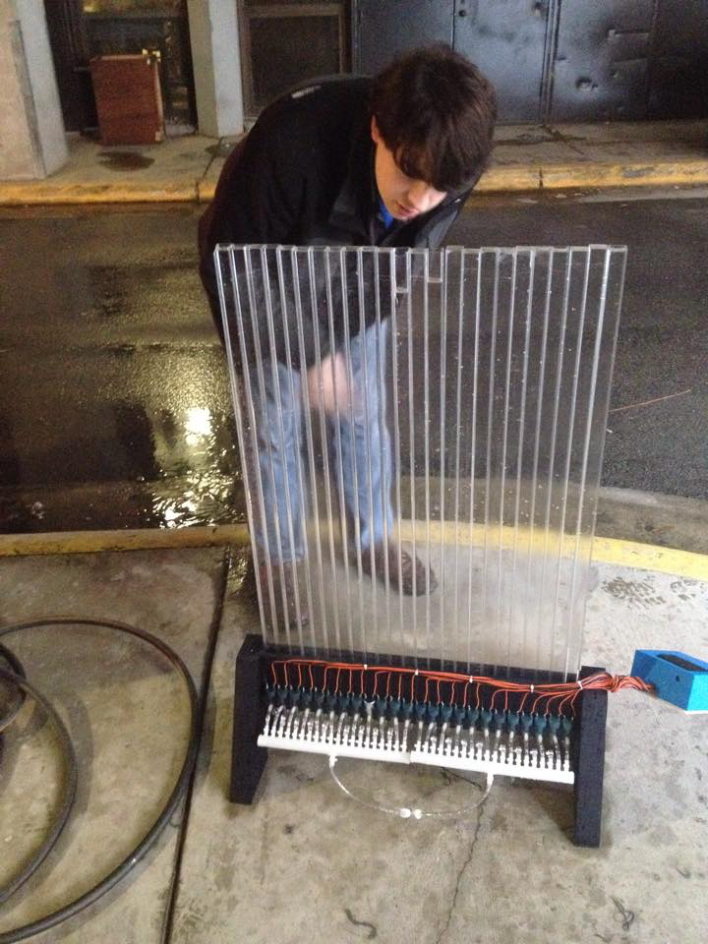
Cleaning
Verified that 2 tubes were leaking
One has a crack at the bottom
The other at the top
We don’t want to make the prototype lab sticky
It is easier to identify leaks with water

Slide 4

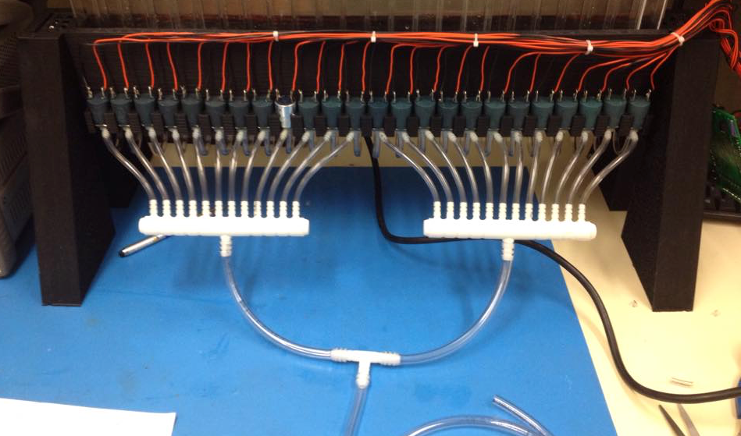
Replacing air lines
Old setup
Main line was too thin
Air leaks
No leaks!
Very good airflow

Slide 5
Testing the new setup
Verify that we “have enough air”
See which tubes are not working
Replace solenoids
Replace valves
Make sure we can open all tubes at once
Verify bubble patterns

Slide 6
Testing the new setup
Test
Trigger all tubes at once
Vary pressure and scan opening times

Slide 7
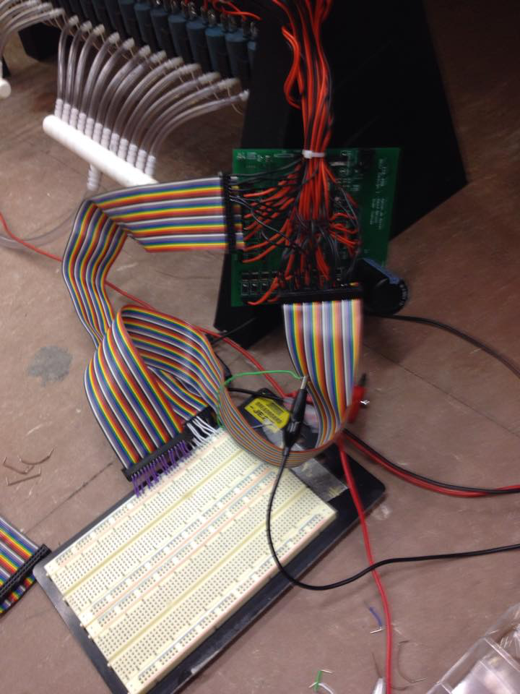
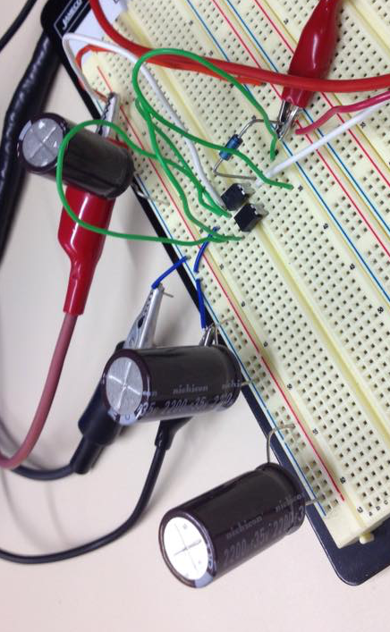
Circuit….
Not very pretty
Needed to isolate the testing circuit from the board
Big capacitor powered all circuit up

Slide 9
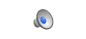


Slide 10
Problems
Some valves must be replaced
Some solenoids can’t open
Patterns difficult to see, bubble detection may not work
Same tube, bubbles can be big and small
High pressures pounding tube created leaks

Slide 11
Problems

Slide 12
Next week
Fix leaking tubes
Waiting on check valves
Work more on making the solenoids work more uniformly

